Slide 1
building intelligent cognitive system

Slide 2
Team members
List your team members’ full name (as in your course registration)

Slide 3
Case study
Objective: Intelligent cognitive system for logo design
Read the case study document “CGS Day3PM Case Study.docx” in the LumiNUS folder.
Discuss the following five questions.
Q1. Knowledge collection
Q2. Knowledge Representation
Q5. Final system
Q3. Cognitive design for Human-Computer Interaction
Q4. Reasoning with KB

Slide 4
Question 1
In order to gather example images for LD Assistant to learn the user’s preferences about design elements, one of the steps in logo generation is to ask the user to indicate his/her preferred sample logos.
Two solutions are proposed:
A) allow user to upload photos of existing brands they like;
B) provide some sample logos generated by the cognitive system itself.
Evaluate the two solutions with justification.

Slide 5
Answer 1
Provide your answers to Q1.

Slide 6

Question 2
Cognition is about selecting the right kind of action given a particular input from the world. Assuming the logo below has been selected by users as their preference, your cognitive system should learn the corresponding knowledge that can precisely represent the users’ preference.
Design the knowledge base using Frame Systems in order to represent the knowledge learned from this sample logo.
Hints: What are the objects, slots and fillers? How are the objects linked? The slots having empty fillers can be omitted.

Slide 7
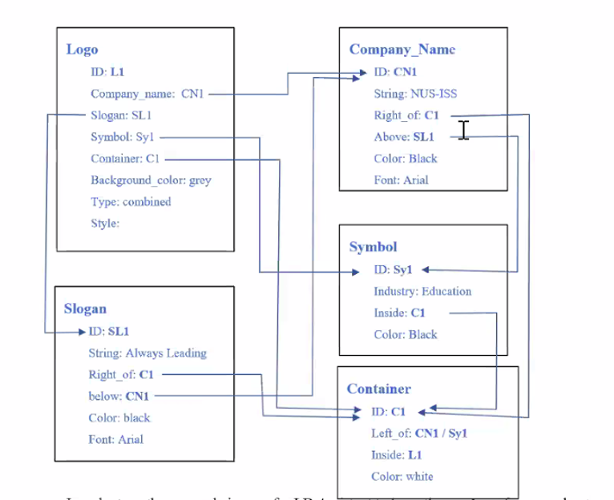
Answer 2

Slide 8
Question 3
LD Assistant is expected to have a conversational user interface, through which users may interact with the system using utterances as well as button selections of visual prompts.
Define the high level intents to be detected from user’s utterances.
Define the slots to be collected, and indicate with justification which slots to be extracted from utterances and which from button selections.

Slide 9
Answer 3
Provide your answers to Q3

Slide 10
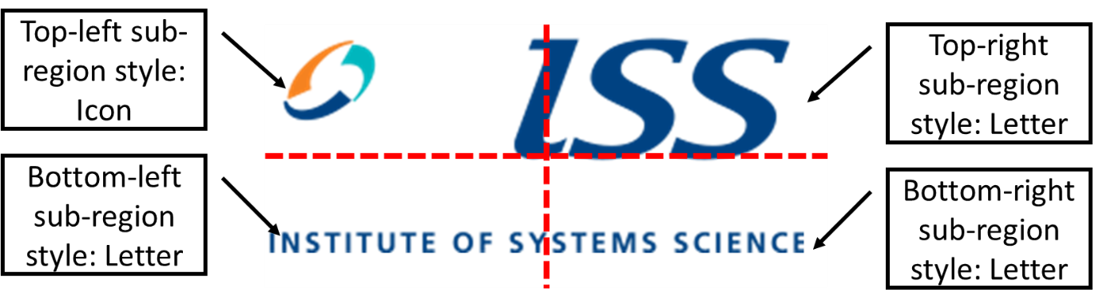
Question 4
You are asked to develop a cognitive vision recognition engine to automatically recognize the logo image style (e.g., Classic design or Modern design). The logo image is split into four non-overlapping sub-regions, each sub-region is classified as one of two categories (i.e., Letter or Icon). The whole logo image style can be inferred from the four sub-region styles sequence, which is in the order of top-left, top-right, bottom-left, bottom-right sub-regions. For example, the logo image illustrated has a sequence of sub-region styles as {Icon, Letter, Letter, Letter}.
Propose how to apply the hidden Markov model (HMM) to build a logo classification model based on its sequential information of image content.

Slide 11
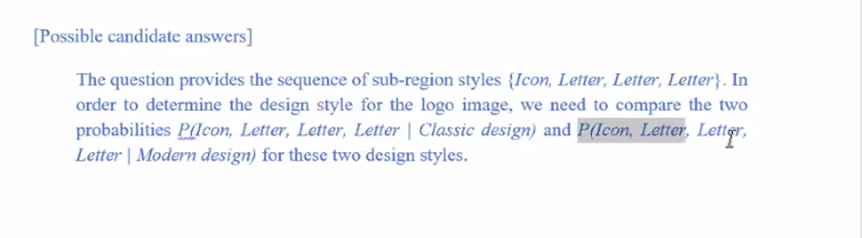
Answer 4

Slide 12
Question 5
Demonstrate, e.g. using process flowchart or modular design chart, your system design and technical components to achieve the goal of logo auto generation and modification. For each module, define the input/output and propose the solution.

Slide 13
Submission guideline
Rename the file name to be your team name, upload the .pptx file into the LumiNUS.

